Slide 1

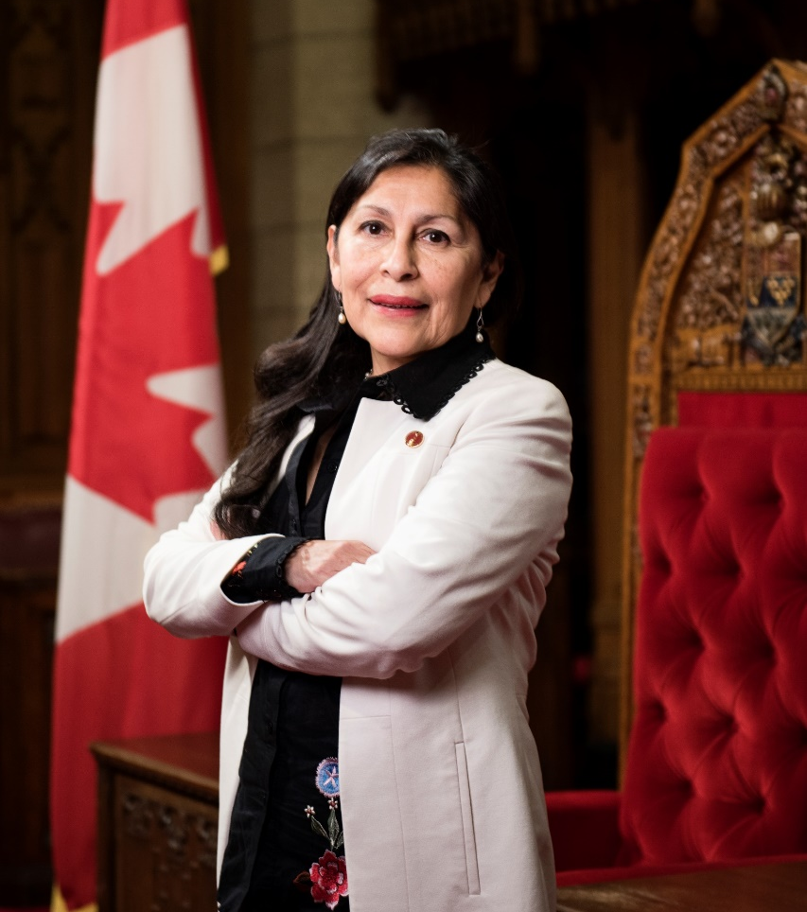
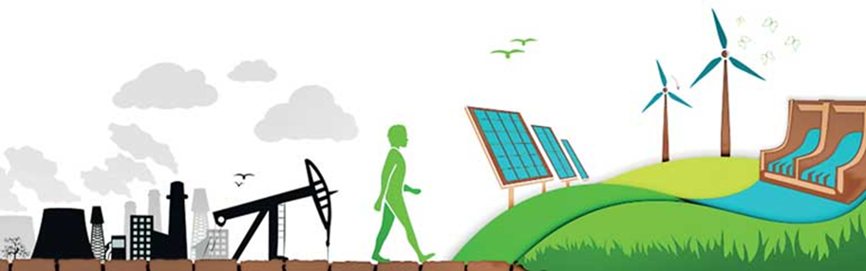
Financing the Future: Advancing a Climate-Aligned Federal Financial Framework
Senator Rosa Galvez, Ph.D., P. Eng., FEC, FCSCE, FCAE
December 10, 2025
Citizens’ Climate Lobby Canada Education Call

Slide 2
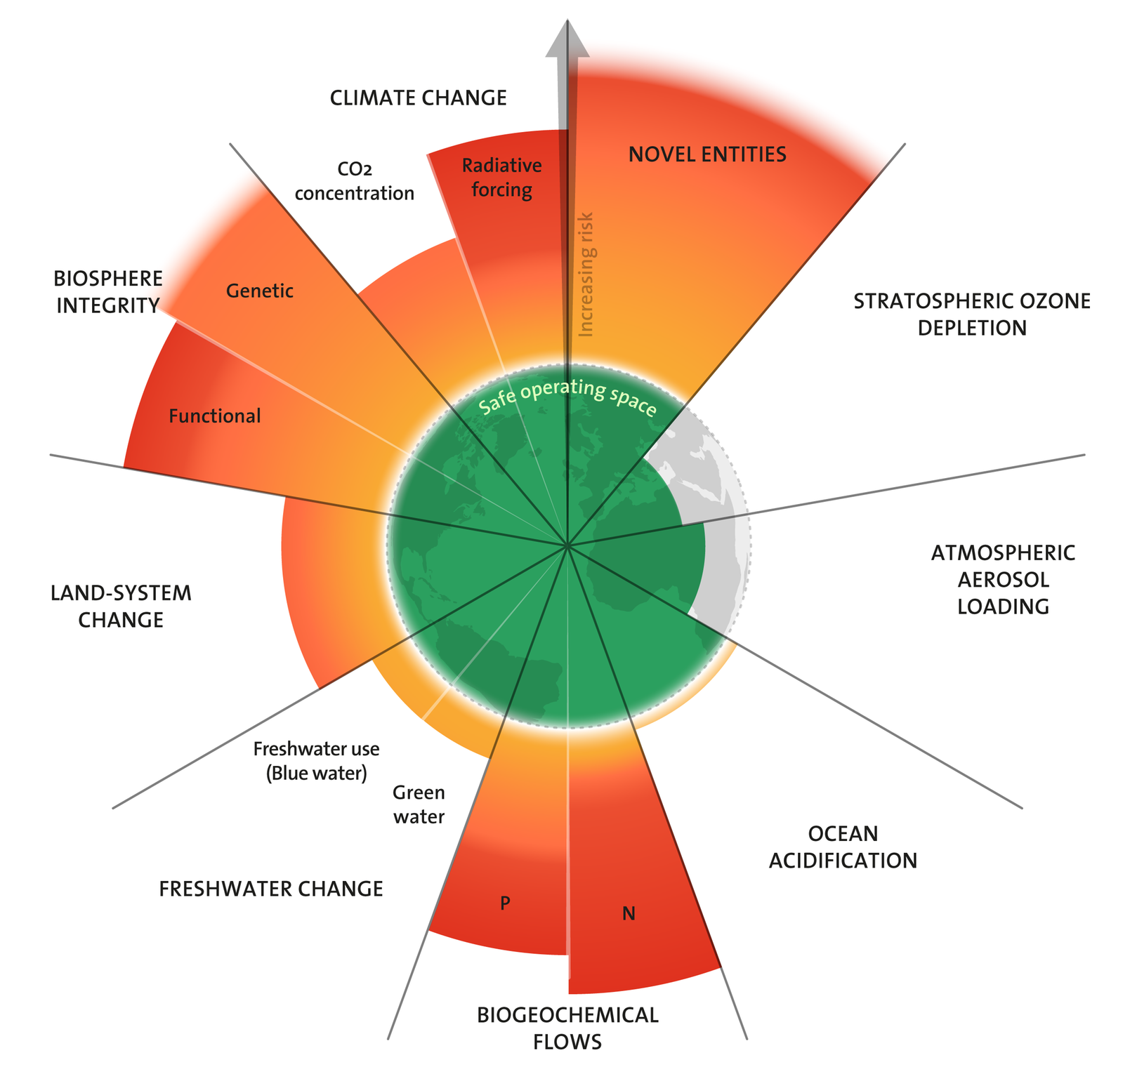
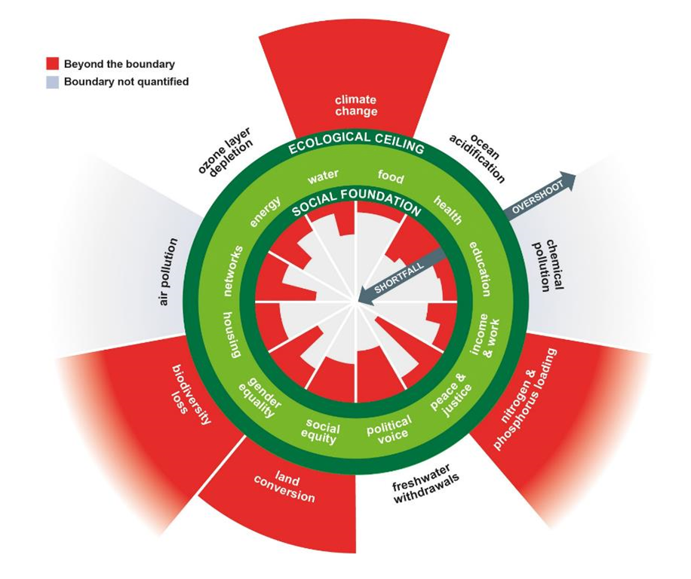
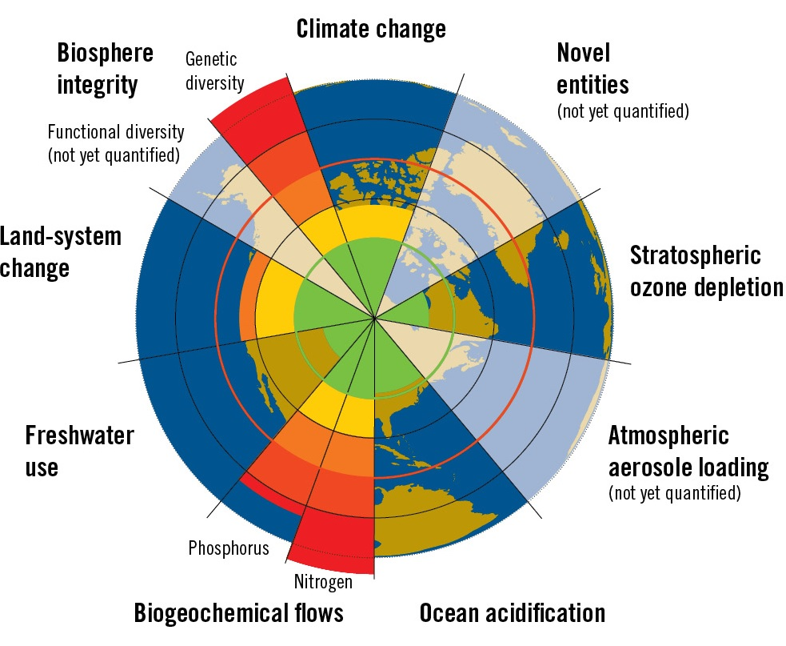
Planetary Boundaries & Limits of Economic Model
We have now exceeded the limits of 7/9 planetary systems essential for human and ecosystem viability adding freshwater change and novel entities while ocean acidification is close to being breached
Ocean acidification has been breached for the first time while human-made chemicals, plastics, and other novel entities continue to increase.
All 7 breached boundaries show trends of increasing pressure – suggesting further deterioration & destabilization of planetary health in near future
Suggests Earth is now well outside safe operating space for humanity (Sakschewski et al., 2025)
Planet warming due to GHGe is known since the 70s
Scientists describe PBM composed of 9 processes that regulate the stability and resilience of Earth for human-ecosystem life.
Crossing these limits are causing irreversible environmental changes on a large scale.
The safe operating space for 4/9 were exceeded by 2009 (climate change, disruption of biogeochemical cycles (P, N), loss of biosphere integrity, biodiversity loss and species extinction) (Rockstrom, 2009)
The centre of the model depicts the proportion of people that lack access to life's essentials (healthcare, education, equity, …) while the crust represents the ecological ceilings (planetary boundaries) that life depends on and must not be overshot. The donut = safe and just space for humanity to thrive. (Raworth, 2012)

Slide 3
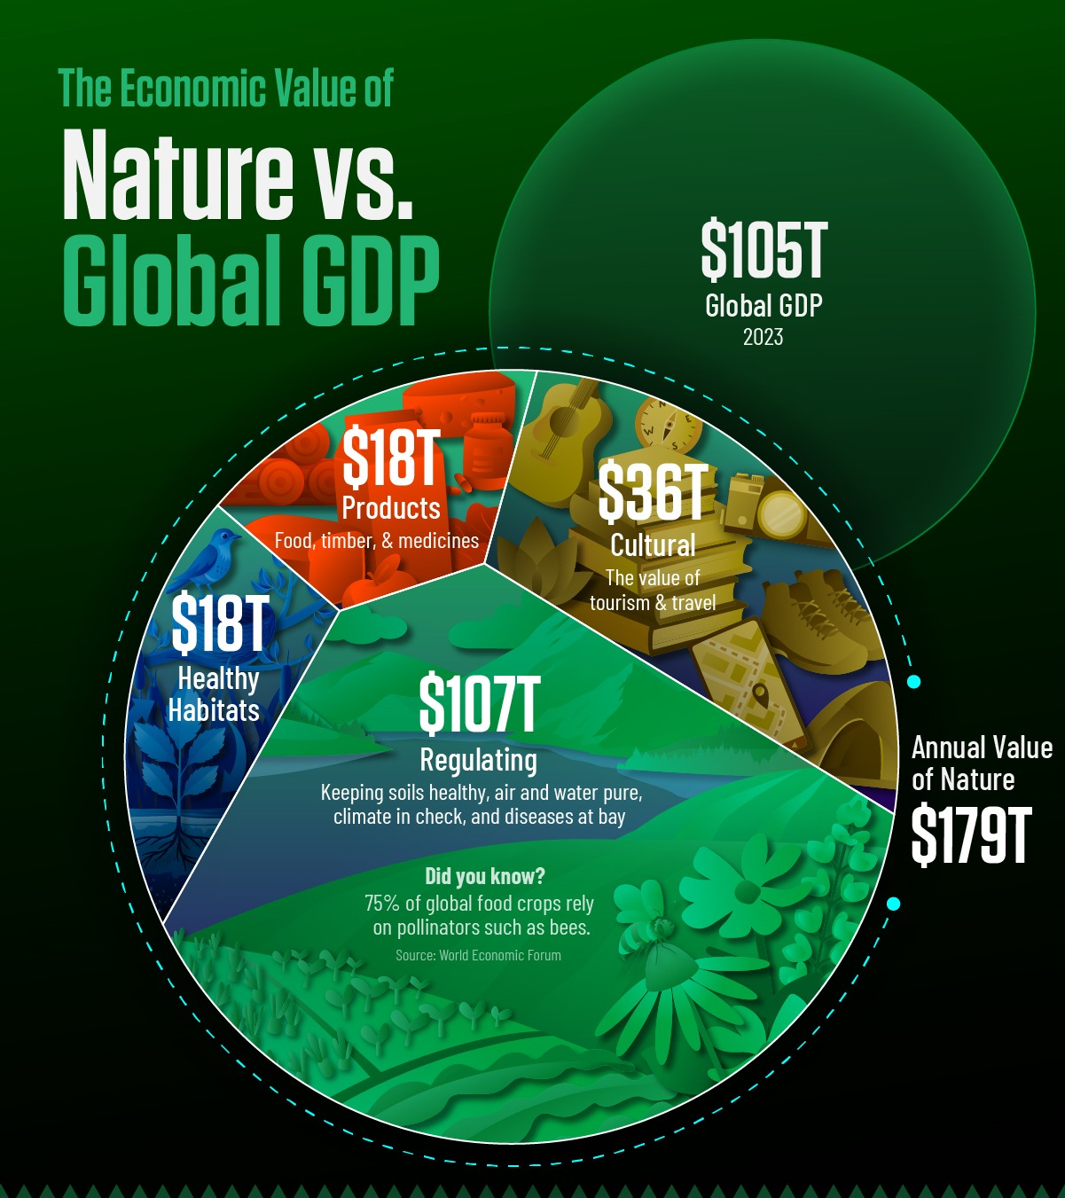
Paradigm Shift: Economy needs nature not the other way around
Most of the global economy, including GDP, relies on nature’s invisible foundation: ecological services, natural resources, and biodiversity. From clean water, fertile soils, and pollination to raw materials and climate regulation, these life-support systems underpin agriculture, industry, and health—making nature the true engine of economic prosperity and resilience.
Preserving Nature’s Value
Beyond an intrinsic value, nature provides immense economic value for society. Yet, continuing business as usual comes at a steep price, with nature’s decline projected to cost at least $479 billion per year by 2050, according to the WWF for Nature. Protecting nature is not just about conservation— it is an economic strategy for avoiding losses.

Slide 4
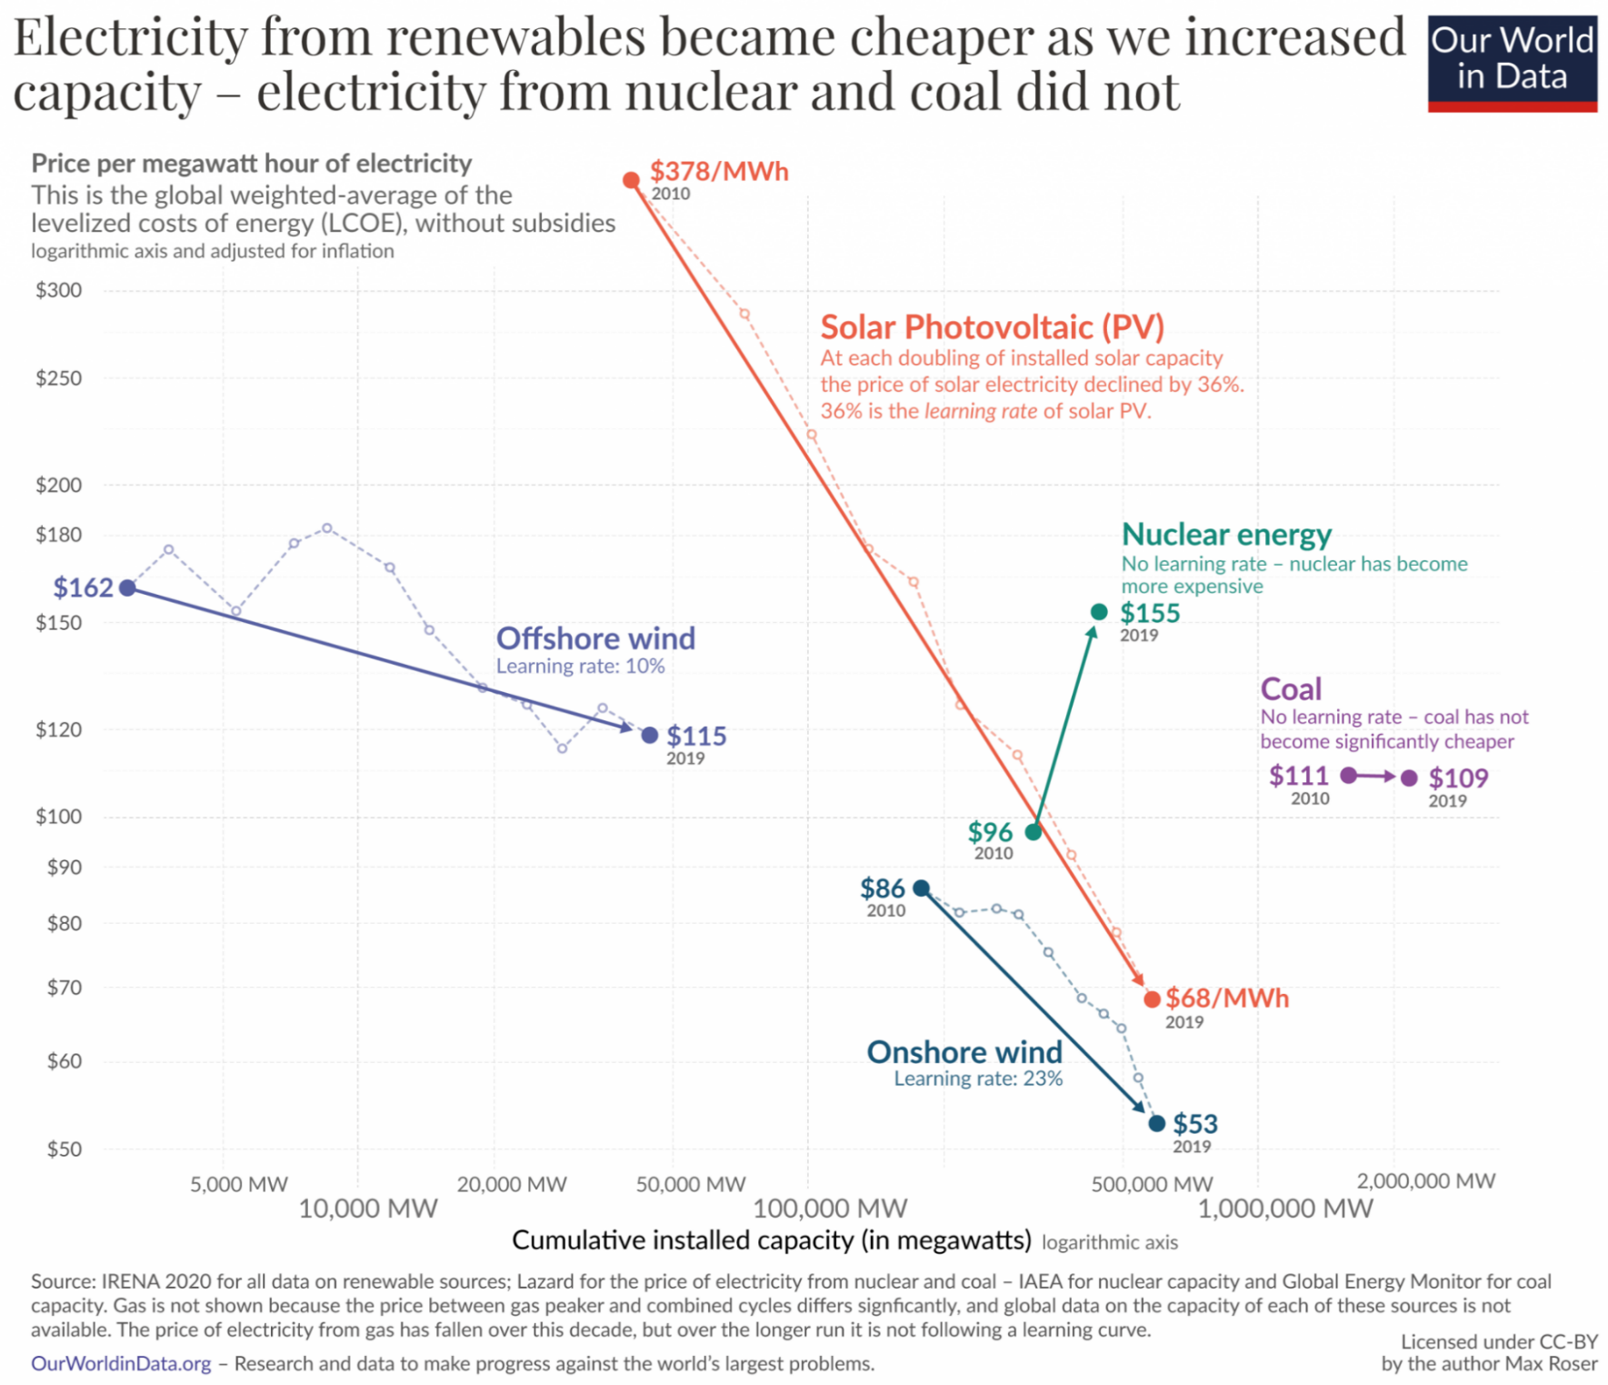
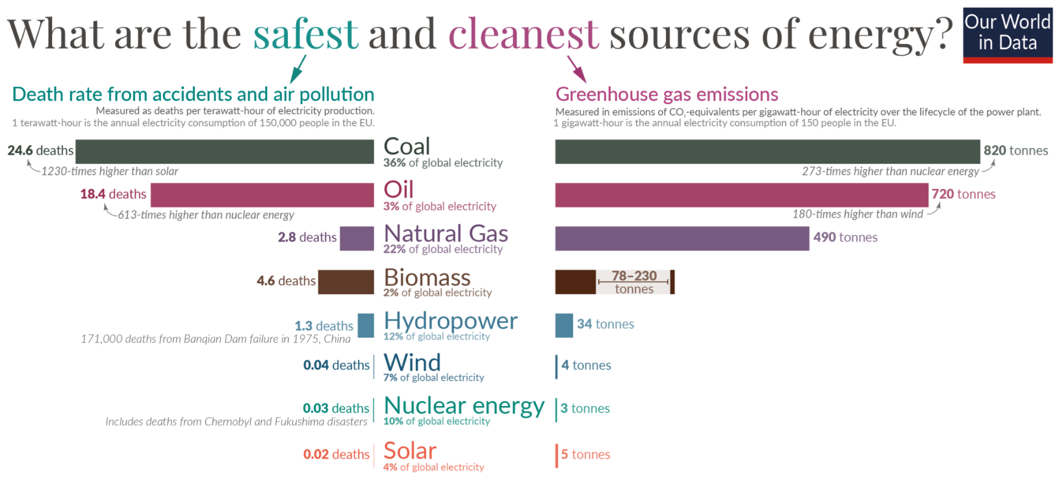
Energy Transition is Unstoppable
Science has proven the causes: burning fossil fuels
Engineers have delivered cheap, safe, clean, sustainable technology
Public opinion is overwhelming: A strong majority of citizens believe the transition to clean energy is more economic opportunity than economic downside.
Based on today’s policy settings: global market for solar PV, wind turbines, electric cars, batteries, electrolyzers and heat pumps is set to rise from $700 billion in 2023 to more than $2 trillion by 2035 – close to the value of the world’s crude oil market in recent years.
Climate change impacts will reduce global GDP by an estimated 3% by 2050.
⚠Fossil-fuel economy = inflation-prone, volatile, geopolitically risky ✔ Renewable-energy economy = deflationary, stable, innovation-driven.
The cost of inaction: meeting 1.5ºC rises by $5 trillion/y of inaction.
Climate Accountability NZ2050 Policy
X Sustainable Finance Regulations Aligned with Climate Goals
X Unleash Cashflow for Transition
4
Notes:
Oct. 30, 2024 - Global market for key clean technologies set to triple to more than $2 trillion over the coming decade as energy transitions advance - News – IEA
Abacus Data Poll (Oct 2019): Across the country, 73% say they prefer to see Canada supporting the growth of our renewable energy and clean technology sectors, while 27% prefer to see Canada put more emphasis on extracting the most value possible from our fossil fuels.
Abacus Data Poll (Sept 2019): 9 in 10 voters see climate action as important or urgent – 10% think it is not important.
Cost: The IPCC Special Report on Global Warming of 1.5°C released in 2018 projected annual average investment needs in the energy system of approximately USD 2.4 trillion between 2016 and 2035, representing about 2.5% of the world’s gross domestic product (GDP) (IPCC, 2018)

Slide 5
A NZ Path: Just Transition + Sustainable Finances
Clean Energy Infrastructure Investment
Building Efficiency Retrofits
Investment in Education and Training
Natural Capital Investment
Clean Research and Development
Circular Economy
Low-carbon growth
Clean-Technology development
Low-carbon and resilient infrastructure investment
Conservation Regeneration of ecosystems
Clean Air
Inclusive resilience
Low-carbon jobs
Technology adoption
Low-carbon and resilient trade and competitiveness
Clean- Affordable energy
Notes:
As we transition to a greener economy, how can government policy support both the workforce and industries impacted by this shift

Slide 6
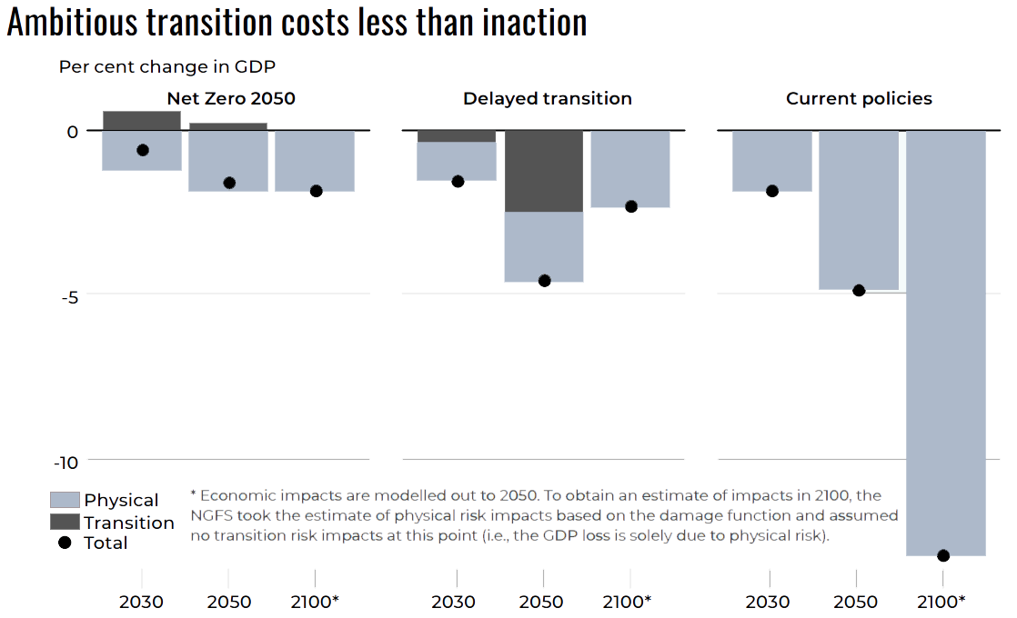
Benefits of Ambitious Action
An ambitious transition costs less than inaction
Well-designed policies can:
Better plan and structure transition
Drive down the costs of reducing emissions
Create the conditions for a just transition
Make the government and financial institutions more transparent and accountable
Generate finance for truly clean technologies
Contribute to broader sustainable development efforts
Carry co-benefits for other social and governance goals
Source: Canadian Climate Institute
https://rosagalvez.ca/en/initiatives/clean-and-just-recovery/
Notes:
This graph shows the economic costs of our current policies which are insufficient, compared with the lower economic costs of reaching net-zero by 2050.

Slide 7
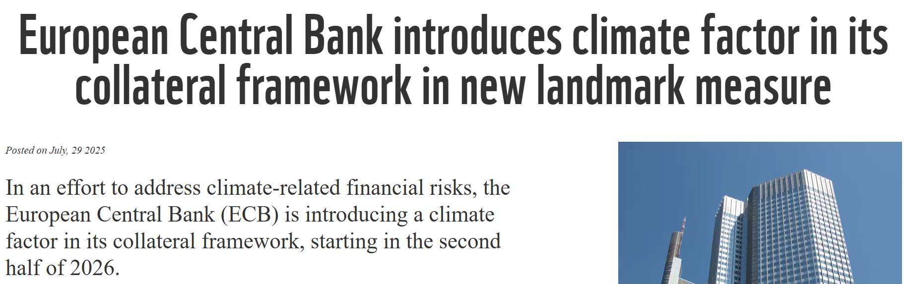
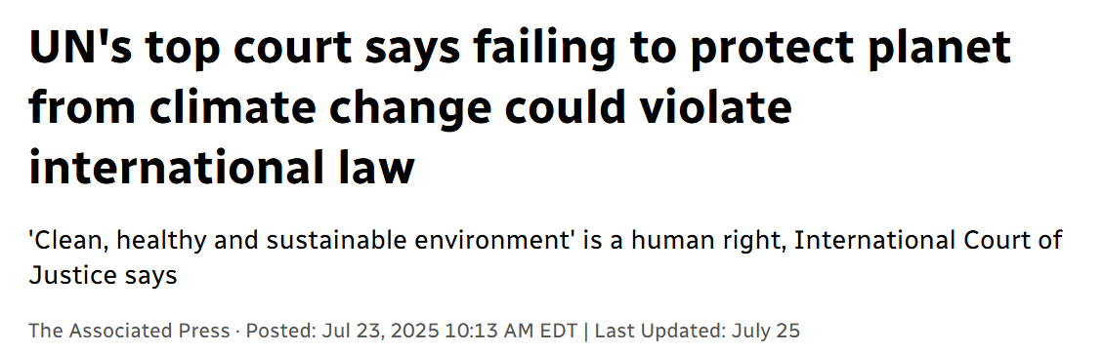
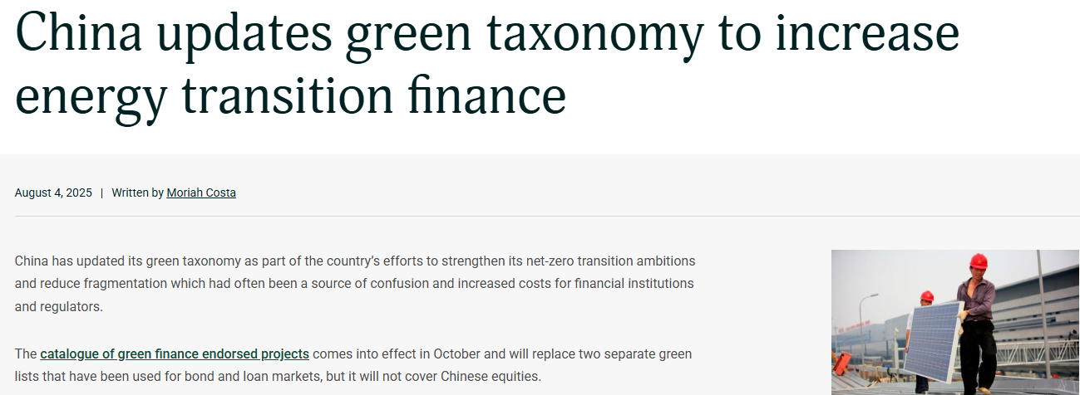
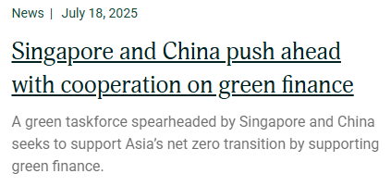
Recent Developments Around the World
Canada is lagging behind its peers!

Slide 8
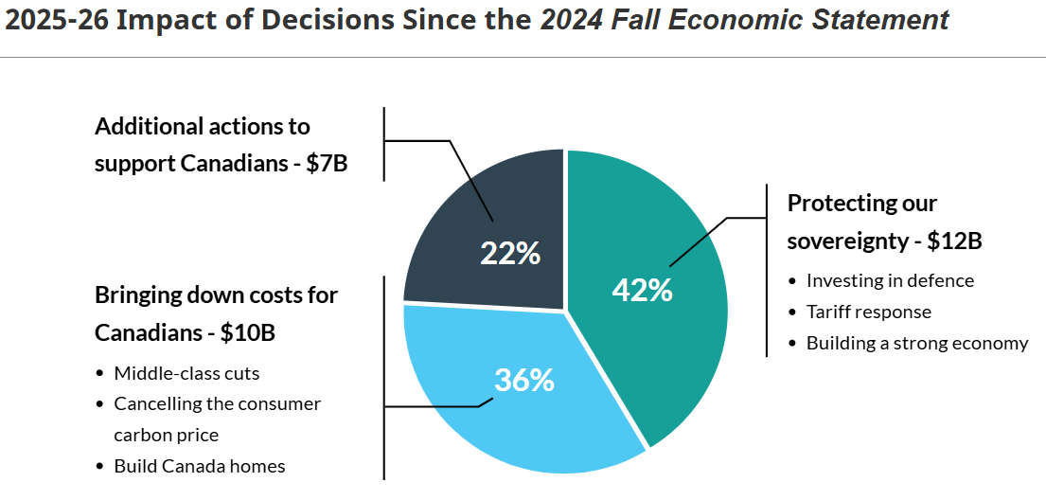
Budget 2025: Canada Strong
Climate-Competitiveness Strategy
Initiatives provide continuity but:
Fall short of acceleration needed to compete in global economy already moving toward clean technology.
Repackages prior commitments and re-profiles existing initiatives.
Small steps toward climate preparedness but falls short of the scale the crisis demands.
Sustainable Finance
Reconfirmed intent to move forward with “Made-in-Canada” taxonomy but completion delayed until 2026.
Indicated intention to explore development of a Sustainable Bond Framework.
What’s Missing
Legislation that would directly promote and advance environmental protection e.g., Nature Accountability Act
Green Nation-Building Fund to enhance renewable energy & adaptation efforts in collaboration with Indigenous partners.
Indigenous climate-leadership capital fund
A Finance-Sector Alignment Framework like CAFA
https://budget.canada.ca/2025/report-rapport/intro-en.html
Notes:
The government calls its Climate-Competitiveness Strategy a “central pillar” of the plan to make Canada the strongest economy in the G7—based on results, not objectives. While these initiatives provide continuity, they fall short of the acceleration needed to compete in a global economy already moving toward clean technology. The new post-2030 carbon-pricing trajectory and the “improved backstop” simply repackage commitments made years ago. The much-touted carbon contracts for difference are likely too small to transform markets, while the suite of refundable tax credits extends programs launched between 2022 and 2024. The Critical Minerals Sovereignty Fund, worth $2 billion over five years, re-profiles existing Natural Resources Canada initiatives.
Budget 2025 takes small steps toward climate preparedness but falls short of the scale the crisis demands. It commits $40 million over 2 years to launch a Youth Climate Corps to train young Canadians to respond to climate emergencies and strengthen community resilience. It also allocates $257.6 million over four years to Natural Resources Canada to lease four aircraft and boost aerial firefighting capacity, and $55.4 million to Public Safety Canada to develop a new National Public Alerting System for timely disaster warnings. These are positive measures—but modest when measured against record-breaking wildfires, floods, and insurance losses that already cost Canada billions each year. Training youth to respond is vital; equipping the country to prevent and withstand these disasters is what leadership requires.
The taxonomy is an essential part of Canada’s transition to sustainable finance and should be instituted promptly to set standards for classifying climate-related financial instruments and benchmarking climate risk management. - https://ccli.ubc.ca/resource/submission-to-finance-canada-as-part-of-its-pre-budget-consultations-in-advance-of-the-upcoming-2025-fall-federal-budget/
https://greenbudget.ca/recommendations/

Slide 9
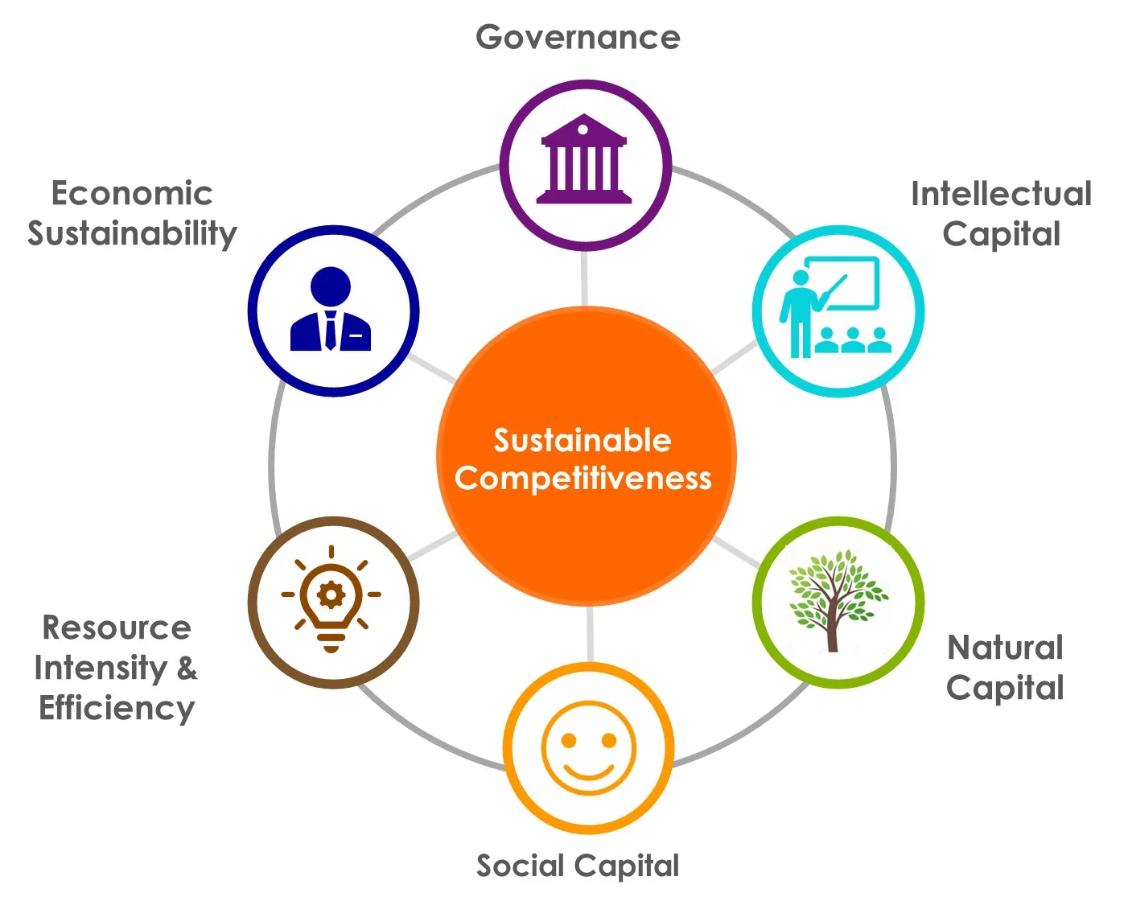
Why Align Financial System with Climate Goals
Economic Competitiveness
Innovation
Addresses multiple crisis: biodiversity, climate change, health, etc.
Energy Independence
Capital flows need to be directed towards renewable and clean energy projects (mitigation) and also towards community-led resilience building initiatives (adaptation).
Notes:
https://solability.com/the-global-sustainable-competitiveness-index/sustainable-competitiveness
“The sustainable competitiveness model incorporates all relevant pillars of sustained growth and wealth creation of a nation – natural capital availability, resource intensity, innovation and business capabilities, governance, and social cohesion.
“Sustainable competitiveness is the ability of a country to meet the needs and basic requirements of current generations while sustaining or growing the national and individual wealth into the future without depleting its natural, intellectual and social capital.””
“Sustainable competitiveness means that current wealth levels are not in danger of being reduced or diminished through over-exploitation of resources (i.e. natural and human resources), the lack of innovative edge required to compete in the globalised markets (i.e. education), or the discrimination, marginalisation or exploitation of segments of a society.”

Slide 10
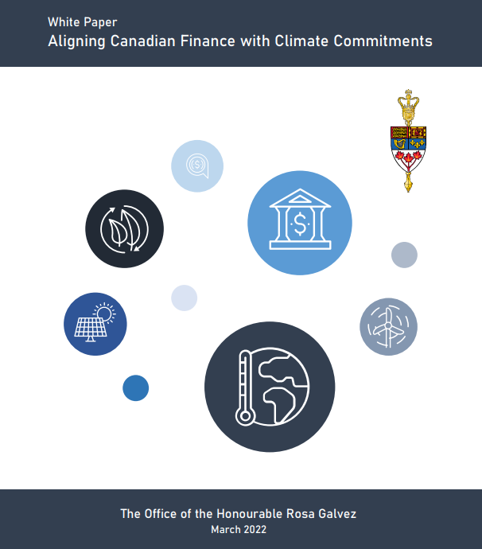
White Paper: Aligning Canadian Finance with Climate
Climate-Aligned Finance Requires:
Avoidance of carbon lock-in;
Target-setting and planning in compliance with a global carbon budget consistent with the Paris Agreement and mandatory consideration of all life cycle emissions;
Capital requirements to account for systemic climate risks generated by the activities of financial institutions;
Respect the rights of Indigenous Peoples and other environmental and social goals;
Avoid conflicts of interest and leverage climate expertise, experience and knowledge; and
Recognize climate change as a superseding interest relevant to all directors’ duties.
Click here to read the White Paper in full

Slide 11
Goals and Objectives - Alignment Requirements
CAFA enables the alignment of federal financial institutions and federally regulated entities with Canada’s legally binding climate commitments. It also provides practical implementation mechanisms for several Acts already adopted by Parliament, including:
• The Canadian Net-Zero Emissions Accountability Act
• The Sustainable Jobs Act
• The United Nations Declaration on the Rights of Indigenous Peoples Act
• The Act to develop a national strategy on environmental racism and environmental justice
In essence, CAFA is an accountability and implementation framework that gives real economic effect to laws that have already received Royal Assent.
Globally, leading financial institutions and international bodies now recognize that climate risk is financial risk. This is acknowledged by the Financial Stability Board, the Network for Greening the Financial System, the Bank for International Settlements, the International Monetary Fund, the World Bank, the Coalition of Finance Ministers for Climate Action, the Investor Network on Climate Risk and also by the Organisation for Economic Co-operation and Development to which, Canada is a founder member since its inception in 1960. Here in Canada, both the Office of the Superintendent of Financial Institutions and the Bank of Canada have explicitly recognized the existence of both physical and transition risks associated with climate change.
Notes:
CAFA aligns the activities of federal financial institutions and other federally regulated entities with the superseding economic and public interest matter of achieving climate commitments.
It aims to promote timely and meaningful progress with a view to safeguarding the stability of both the financial and climate systems. To do so, it recognizes the systemic risks posed to all sectors of the economy by not aligning financial flows with climate commitments.

Slide 12
Bill S-238: Climate-Aligned Finance Act (CAFA)
CAFA does the following:
Establishes a duty for directors, officers and administrators to align entities with climate commitments
Aligns purposes, including market oversight by OSFI, with climate commitments
Obligates entities to develop action plans, targets and progress reports on meeting climate commitments through annual reporting requirements
Makes capital adequacy requirements proportional to microprudential and macroprudential climate risks generated by financial institutions
Ensures climate expertise on certain boards of directors and avoids conflicts of interest
Requires a government action plan to align financial products with climate commitments
Mandates timely public review processes on implementation progress to ensure iterative learning
1
2
3
4
5
6
7
Notes:
Establishes a duty for directors, officers and administrators to align entities with climate commitments;
Aligns market supervision by OSFI with climate commitments;
Obligates the development of action plans, targets and progress on meeting climate commitments through annual reporting requirements;
Ensures climate expertise on boards of directors and avoiding conflicts of interest
Makes capital adequacy requirements proportional to microprudential and macroprudential climate risks generated by financial institutions;
Requires a government action plan to align financial products with climate commitments; and
Mandates timely public review processes on implementation progress to ensure iterative learning.

Slide 13
Bill S-238: Climate-Aligned Finance Act (CAFA)
CAFA considered a “gold-standard bill” but faced significant pushback from Senators, MPs, & parts of financial sector
Critics argued CAFA was too broad, overarching, & prescriptive & stalled the bill in 44th Parliament
To increase likelihood that a reintroduced bill makes its way through legislative process without stalling amendments to three key areas of the act will be made following consultation with experts in August.
Amendment 1
Capital Risk-Weight Requirement
Removed any top-down directions on how capital risk-weights should be calculated, giving more flexibility to OSFI & instead emphasize the recommendation to do so.
Amendment 2
Appointment of Board Members
Remove prohibition that would prevent a person from sitting on a board & replace it with disclosure
Amendment 3
Duties of Directors
Reworded to align with other laws establishing duties for directors, officers and administrators to avoid potential contravention of a director’s obligations under the Bank Act or under the provincial or federal Business Corporations Act

Slide 14
CAFA and a Just Transition
A just transition is one that is centered around people and communities.
CAFA supports a just transition by:
Enhancing the capacity to adapt, protecting those people and communities most vulnerable to climate impacts
Redirecting capital flows from the harmful boom-bust cycle of fossil fuels to more stable and low-carbon energy sources, creating employment opportunities
Adhering to the Paris Agreement, which embeds principles of equity such as “common but differentiated obligations”
Climate-aligned organizations also must respect the Rights of Indigenous Peoples, not make inequality worse, or hinder other social obligations.

Slide 15
CAFA’s Progress Through Parliament
CAFA is currently at First Reading in the Senate.
Current position
Began in
October 2025
The Senate
First
Reading
Second Reading
Committee Study
Report Stage
Third
Reading
First
Reading
Second Reading
Committee Study
Report Stage
Third
Reading
Royal
Assent
The House of Commons

Slide 16



How can you support CAFA?
Write to your MPs
House of Commons Petitions
Email campaigns to Senators to refer to committee
Share CAFA resources e.g., Reintroduction Video, Op-Eds, etc.
TAKE ACTION & VOICE YOUR SUPPORT
#CAFA

Slide 17

Thank you!
And thanks to my incredible team:
Cheryl Soullière
Parliamentary Research Assistant
Alexandra Toutant
Special Assistant
Diego Montes Ferro
Parliamentary Affairs Advisor
Sylvie Bédard
Executive Assistant
Rosa.Galvez@sen.parl.gc.ca
RosaGalvez.ca
@SenRosaGalvez
#CAFA

Slide 18


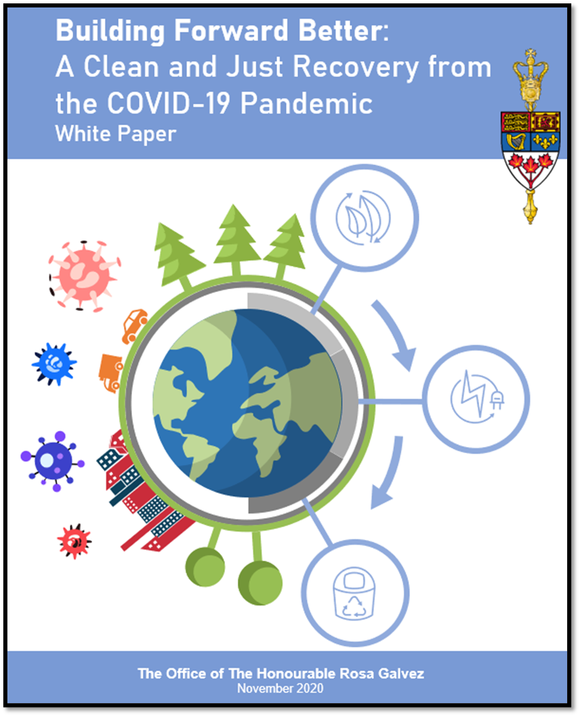
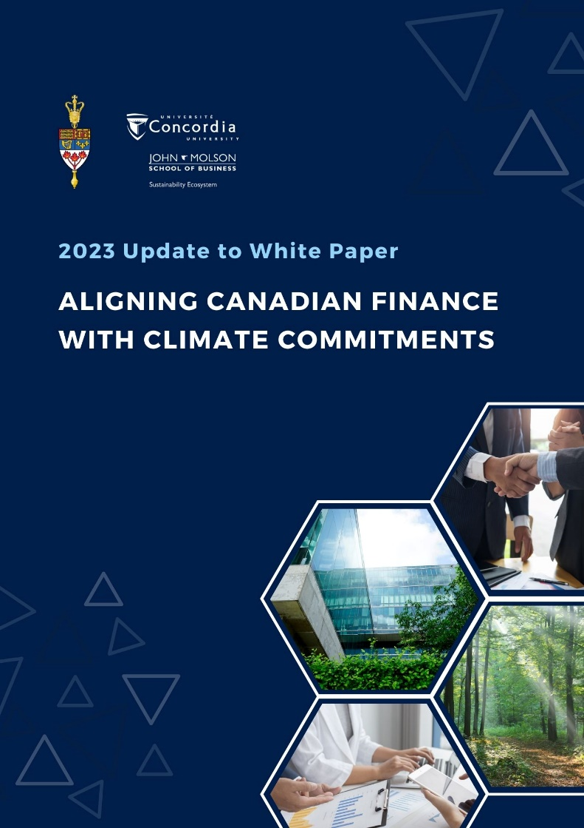
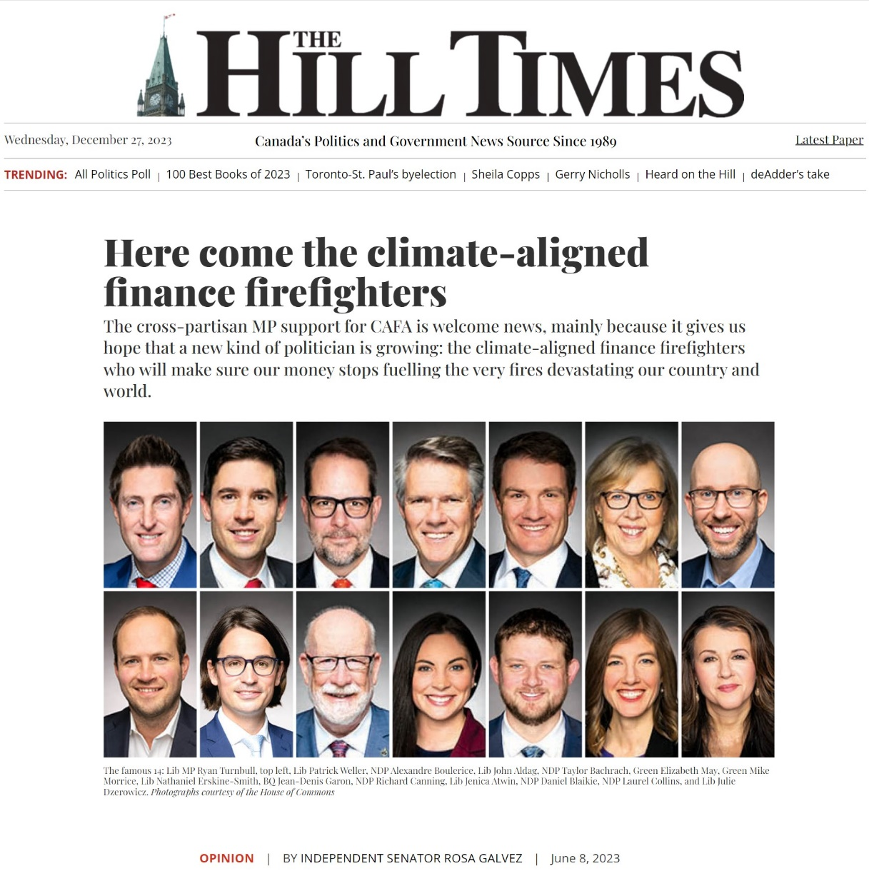
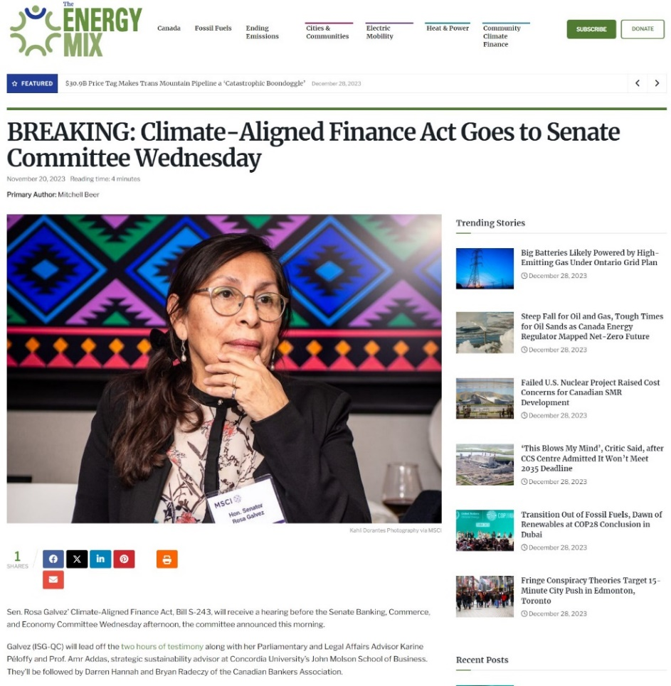
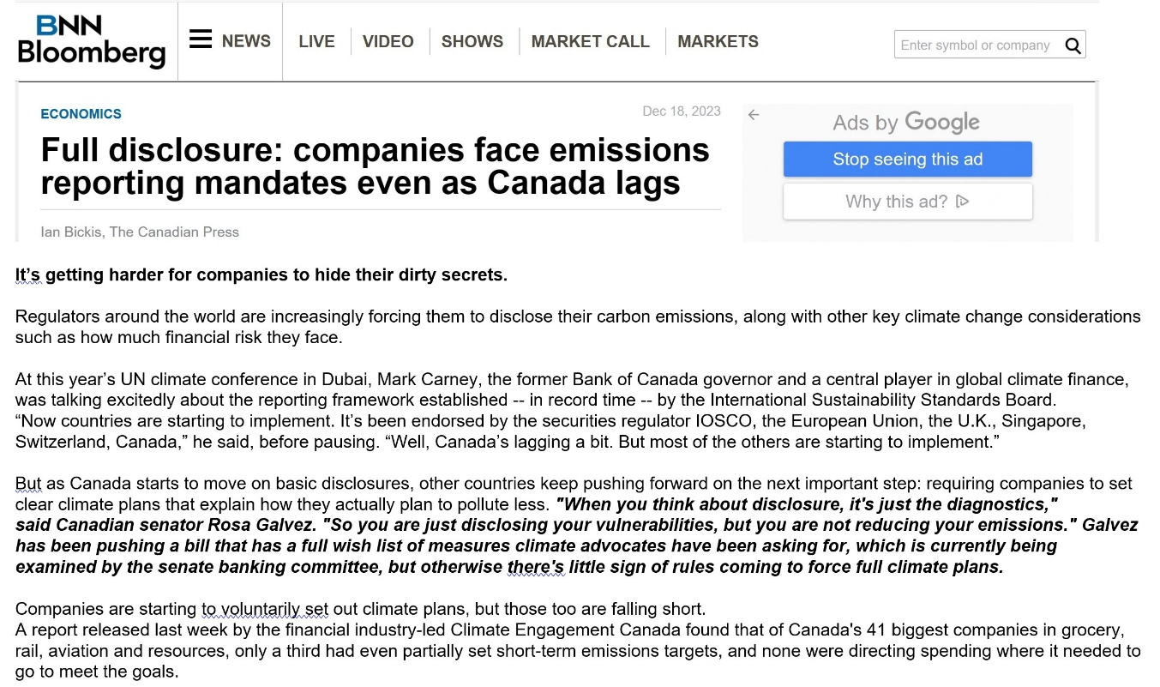
Visit RosaGalvez.Ca

