Slide 1

Generation Climate Action: Mathur v Ontario
Danielle Gallant & Reid Gomme, Staff lawyers at Ecojustice
& Alex Neufeldt, Applicant
October 20th, 2025
Photographer: Tilly Nelson

Slide 2


Mathur v Ontario: the global context
Global political and scientific consensus: governments must cut down emissions by nearly half to keep global warming to 1.5°C and avoid the worst impacts of climate change

Slide 3

Mathur v Ontario: the global and
Canadian context
Rise of the youth climate movement, including Fridays for Future
First legal decision holding a government accountable for a climate target not aligned with science (the Urgenda case in the Netherlands)
However… in 2018, Ontario decided to repeal its previous climate targets and replace them with one weakened 2030 target

Slide 4

Ecojustice’s Approach to Climate Litigation

Slide 5
Mathur v Ontario: the legal case
Argues that Ontario’s 2030 target is unconstitutional because it violates Ontarians’ rights to life and security of the person under section 7 of the Charter because it:
Increases GHG by 200 Mt and is aligned with catastrophic levels of warming, as much as 3-5°C
Will increase the frequency and severity of extreme weather events such as heatwaves, wildfires and floods
Will increase the risk of physical and mental health harm and death for Ontarians

Slide 6
Mathur v Ontario: the legal case
Argues that youth and future generations will be disproportionately impacted, violating their right to equality under section 15 of the Charter, because they:
are more vulnerable to the mental and physical health impacts
will live longer into the future as impacts worsen
Indigenous youth and future generations even more impacted as they have intersecting vulnerabilities

Slide 7
Mathur v Ontario: the legal case
Legal remedies sought:
declaration that the target is unconstitutional and
order that Ontario set a new science-based target consistent with its share of global GHG and revise its climate plan accordingly
Broader goals:
Setting a precedent in Canadian law that governments that contribute to climate change risk violating constitutionally protected rights
Raising public awareness and elevating youth voices

Slide 8
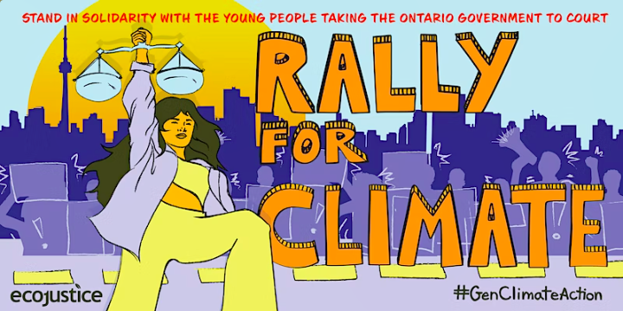
Mathur v Ontario: making legal history (at the Superior Court)
In 2020, became the first Canadian Charter-based climate case to be given the green light to go to a full hearing on the evidence

Slide 9
Mathur v Ontario: making legal history (at the Superior Court)
In 2023, the Superior Court made key findings:
This case is justiciable (courts can decide the issues)
Ontario’s target “falls severely short” of the scientific consensus on the required climate action to keep global warming to 1.5
Ontario’s target is increasing the risk of harm and death to Ontarians, engaging their section 7 Charter rights
However, the case was dismissed because:
it raises “positive rights” (it challenges inaction rather than action)
Ontario’s target is not arbitrary or grossly disproportionate

Slide 10
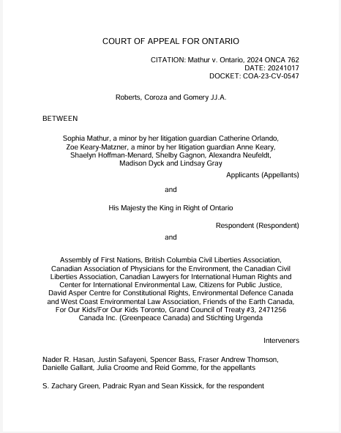
Mathur v Ontario: making legal history (at the Court of Appeal)
“This is not a positive rights case…Ontario voluntarily assumed a positive statutory obligation to combat climate change and to produce the Plan and the Target for that purpose. Ontario was therefore obligated to produce a plan and a target that were Charter compliant. …we allow the appeal.”

Slide 11
Mathur v Ontario: making legal history
Nov. 2019
Charter application filed
Nov. 2020
ON’s motion to strike dismissed
Jan. 2021
Sept. 12-14, 2022
Apr. 2023
Jan. 15, 2024
Court of Appeal hearing
Application dismissed by Justice Vermette
ON's appeal of motion to strike dismissed
Oct. 17, 2024
May 1, 2025
Full hearing before the ONSC
Dec. 1-2, 2025
Re-hearing before the ONSC
Appeal granted by
the Ontario Court of Appeal
Ontario’s Appeal request rejected by the SCC

Slide 12
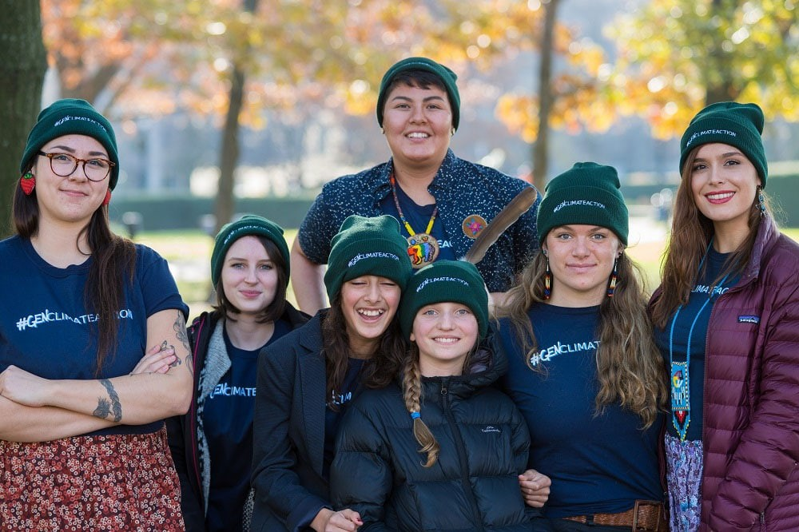
Mathur v Ontario: a youth-led case
The 7 youth Applicants then (2019)…
…And now!

Slide 13
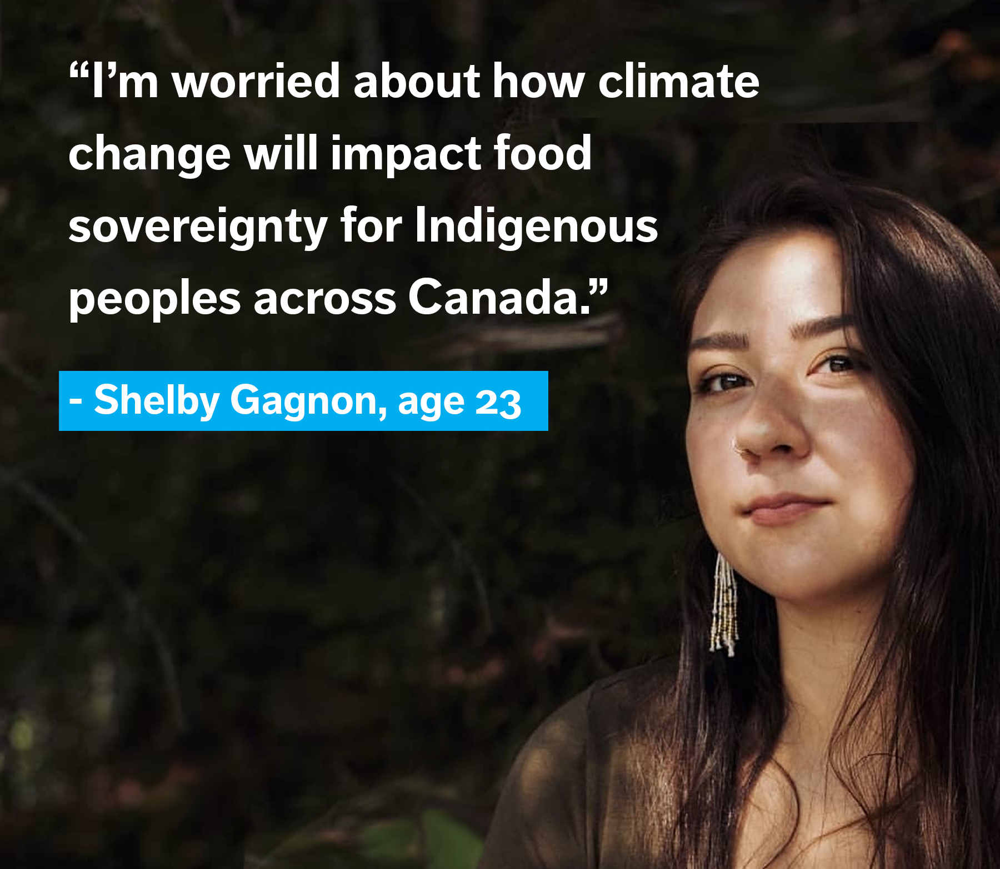
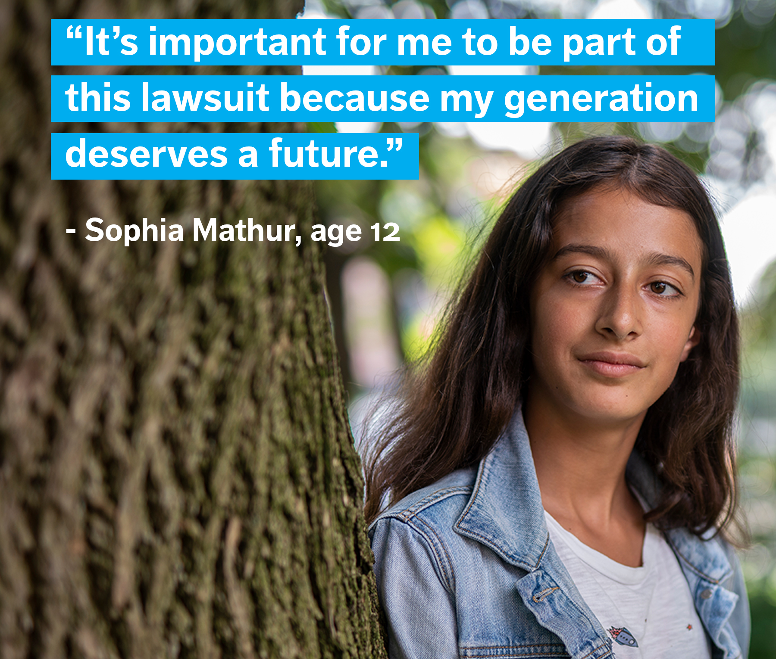
Mathur v Ontario: a youth-led case

Slide 14
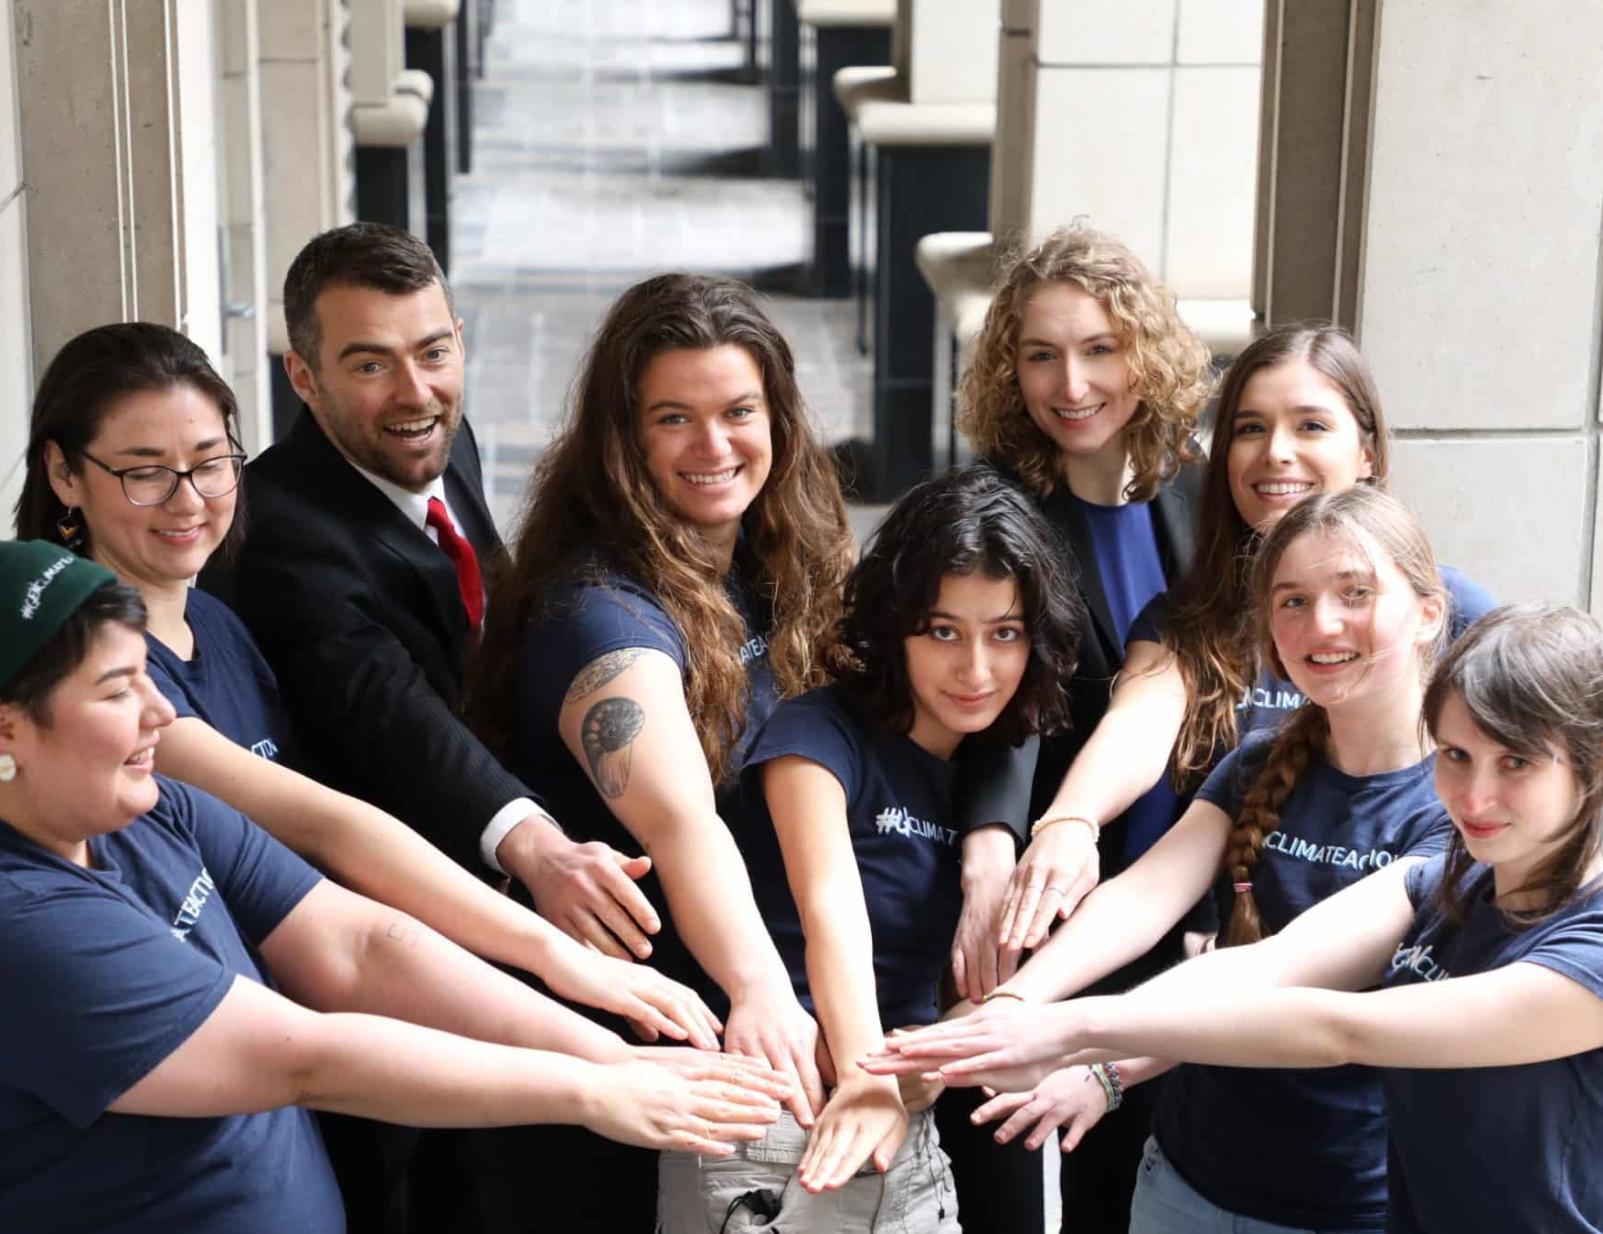
Mathur v Ontario: a youth-led case
Questions for Alex:
What has been your experience of being part of this case?
Is it what you expected, or have some things surprised you?
How are you feeling about going back to the Superior Court in December?
Photographer: Mitchel Raphael

Slide 15
Mathur v Ontario: what happens now?
We are preparing for the Superior Court re-hearing in December
In the meantime… International Court of Justice (ICJ) Advisory Opinion on the Obligations of States in respect of Climate Change – July 2025
Non-binding on Canadian courts, but highly persuasive
Key issues decided:
The obligations of States under international law to ensure the protection of the environment and present and future generations from GHG emissions
The legal consequences of failing those obligations

Slide 16
Mathur v Ontario: what happens now?
Notable passages from the ICJ Advisory Opinion:
Para 242: Targets must "be capable of making an adequate contribution to the achievement of the temperature goal...to hold the increase in the global average temperature to below 1.5°C."
Para 393: A "clean, healthy and sustainable environment is a precondition for the enjoyment of many human rights, such as the right to life...“
Para 427: "Failure of a State to take appropriate action to protect the climate system from GHG emissions...may constitute an internationally wrongful act."

Slide 17
Mathur v Ontario: what happens now?
Lho'Imggin v. Canada, Sept 26, 2026 - Federal Court
Para 64: "In a section 7 Charter challenge where it is argued that environmental harms arising from Canada’s actions and omissions amount to an infringement of the right to life, liberty, and security of the person, the Court may use the ICJ’s reasoning to inform its interpretation of the extent of climate protection guaranteed by the Charter. The principles of fundamental justice at issue must be considered in light of the international norms which they reflect"

Slide 18

Mathur v Ontario: what happens next?
Hearing December 1-2
Focus: whether section 7 deprivations are violations, determination of section 15 violations
Decision in 2026
Further appeals (Court of Appeal and Supreme Court...again!?)
Public support has, and will always, fuel this fight
Donations supporting the case and Ecojustice's work
Civil society demanding climate action – in court, on the ground, at the ballot box

Slide 19
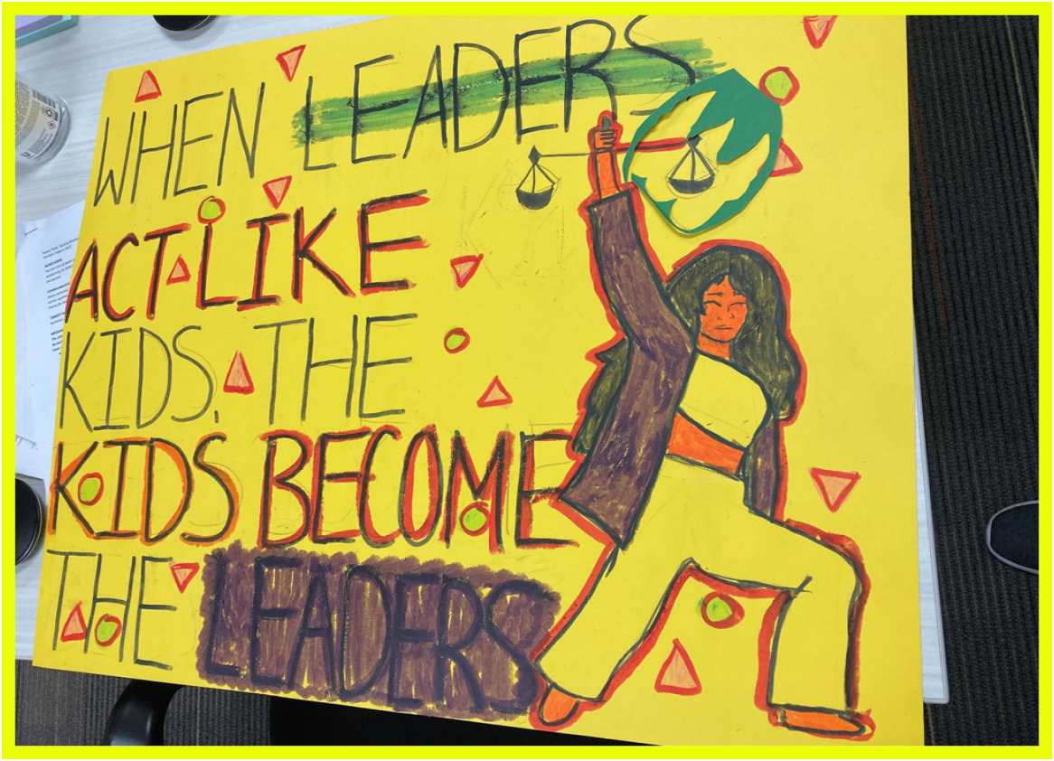
Questions?
Artist: Sophia Mathur

